Slide 1
Capstone Project
The Battle of Neighborhoods

Slide 2
Introduction
There are many factors which can influence coffee shop business, but most popular are:
how many people are passing buy
location of other food services
location of other coffee shops nearby

Slide 3
Data
Wikipedia page with all Moscow districs
Foursquare API
GoogleMaps API
GIS lab data with administrative okrugs

Slide 4
Most popular district
District | Venue Count in center in 500m radius
Arbat District | 100+
Tverskoy District | 86
Zamoskvorechye District | 85
Presnensky District | 72
Chertanovo Tsentralnoye District | 55

Slide 5
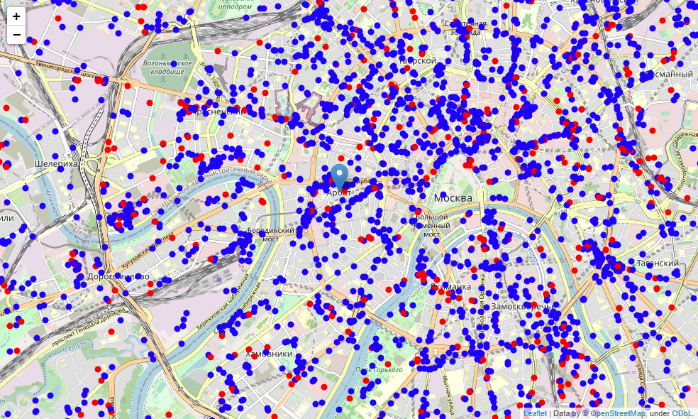
Food services and coffee shops
Blue — food service
Red — coffee shop
Nearly ~15%
of all food services
are coffee shops

Slide 6
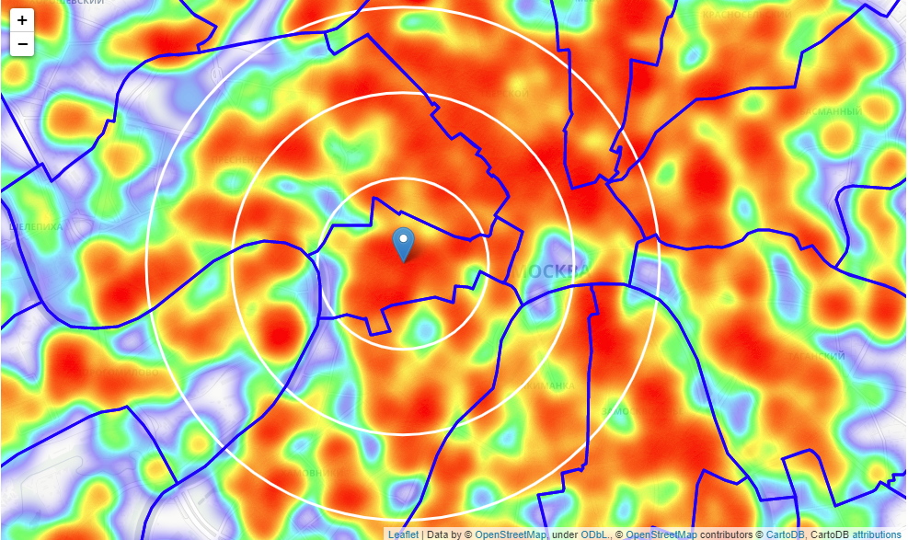
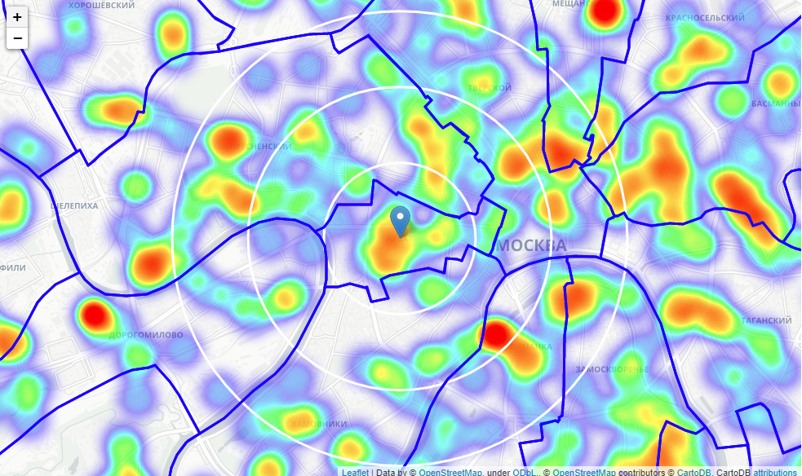
Density of all food services
Regular heatmap
Inverted heatmap

Slide 7
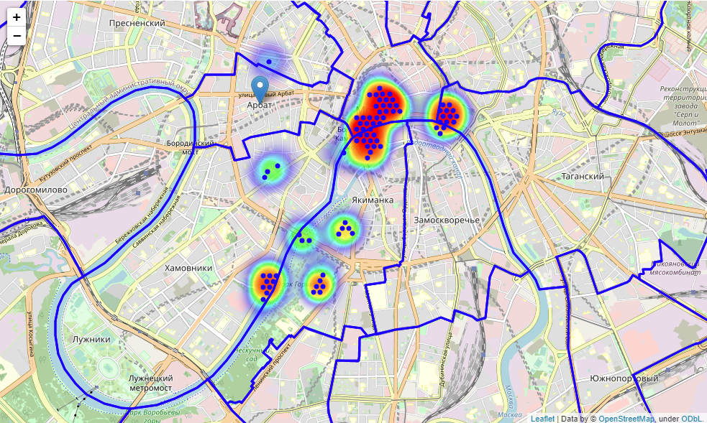
Potential candidates
Criterias:
no more than 5 food services nearby
no coffe shops in 150m

Slide 8
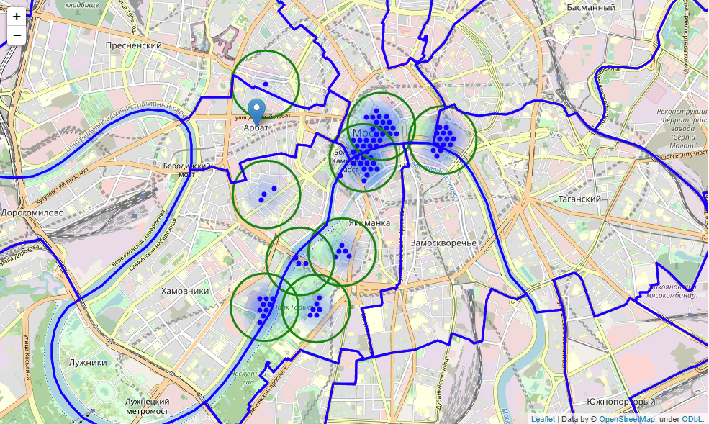
Clustering
Addresses for cluster districts:
Bolshoy Moskvoretsky Bridge
Prechistenskiy Pereulok
Park Gor'kogo
Stolovyy Pereulok

Slide 9
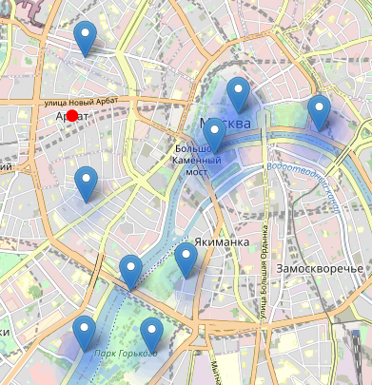
Candidates
There are total 9 candidates:
Kitaygorodskiy Passage
Leninskiy Prospekt, 6, строение 7
Sofiyskaya Embankment, 12
Spasskaya Ulitsa
Krymsky Val, 9 строение 45
Frunzenskaya Naberezhnaya, 22 строение 1
Stolovyy Pereulok, 11 строение 2
Chistyy Pereulok, 5А
Yakimanskiy Pereulok, д. 6

Slide 10
Conclusion
List of candidat adresses is just a recomendation list where to start next search
We should concider many other factors before make final dicision

